Slide 1
Measuring Magnetic Reconnection in Solar Flares
Audrey Robison
MSU REU 2022
Advisor: Dr. Jiong Qiu

Slide 2
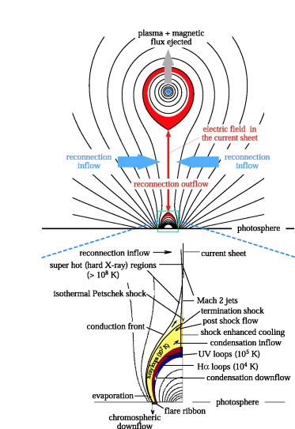
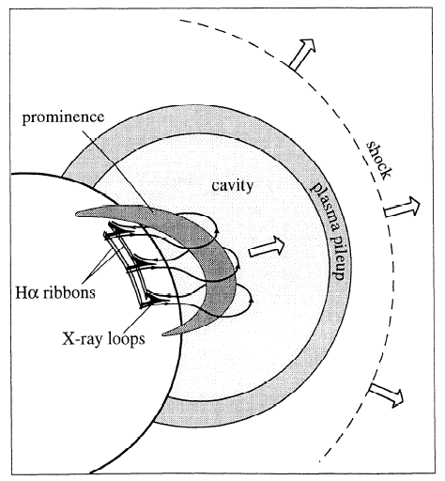
Magnetic Reconnection on the Sun’s Surface
Forbes- Lin model
Notes:
What is the solar flare, how is it associated with magnetic reconnection. As a coronal mass ejection breaks away from the sun, reconnected loops are left on the surface of the sun, these are solar flares. Energy is released into a solar flare due to magnetic reconnection. This energy brightens the feet of the solar flare, what we call the ribbons. The ribbons brighten and propagate outward, as the solar flare evolves.

Slide 3
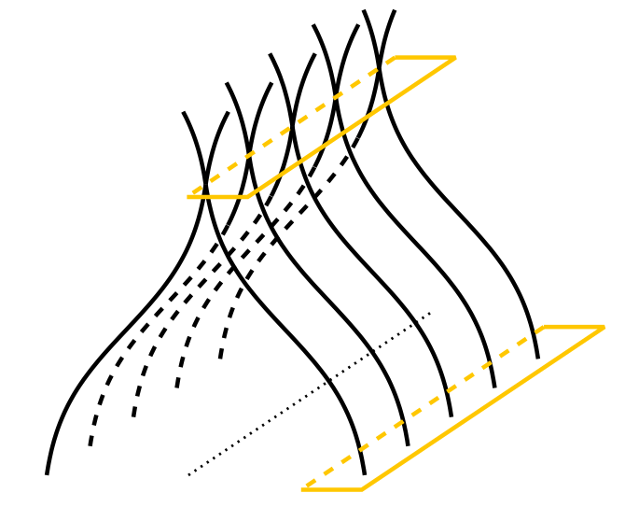
Theories of Reconnection
B_{in}
reconnection
V_{in}
dA_{in}
B_{R}
reconnection
rate (general)
dA_{R}
Terry Forbes
Notes:
Flare ribbons are the location where the energy flows into the chromosphere mapping where reconnection has taken place. Over time, as more field lines reconnect, the flare ribbons move outwards, as field lines further out have reconnected. The flare ribbons brighten before the loops brighten because there is a time delay of when the energy can travel up through the field lines to brighten. Thus, the flare ribbons brighten before their associated flare loops have brightened. As time progresses, the flare ribbons will bloat and travel outwards, as the inner lines have connected the outer lines will begin to connect.

Slide 4
Research Question
Measuring reconnection rate in solar flares
Measuring reconnection shear in solar flares
How much energy is released during the flare evolution when reconnection rate and shear vary

Slide 5
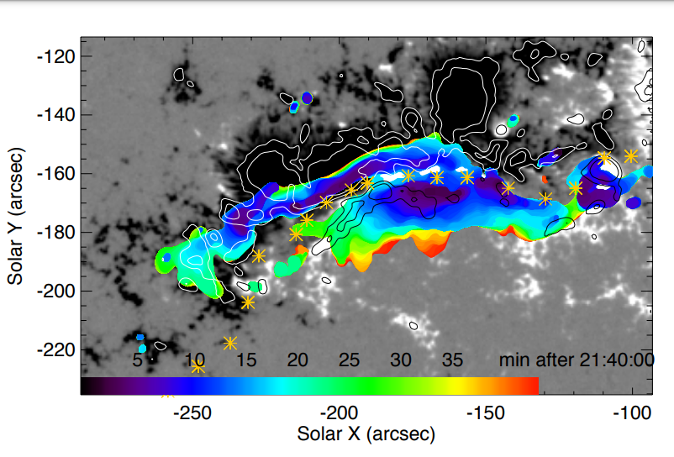

Measuring Reconnection Rate
B_{in}
reconnection
V_{in}
dA_{in}
B_{R}
reconnection
rate (general)
dA_{R}
$$Φ_{B}= \int{B_{in}}{dA}_{in}=\int{B_{R}}dA_{R}$$
Notes:
The amount of flux out must equal the amount of flux into the page. Using the identified flare pixels we can measure the flux in and out of the page using our magnetic data. Using this data over time we can estimate the rate of reconnection by taking an integral of this value. In this first image we have mapped the flare pixels with the general pixels that they connect to because the portion of flux in the blue is equal to the amount of flux in the blue on the other side.
Evolution of flare ribbon over magnetic field, color indicates times

Slide 6
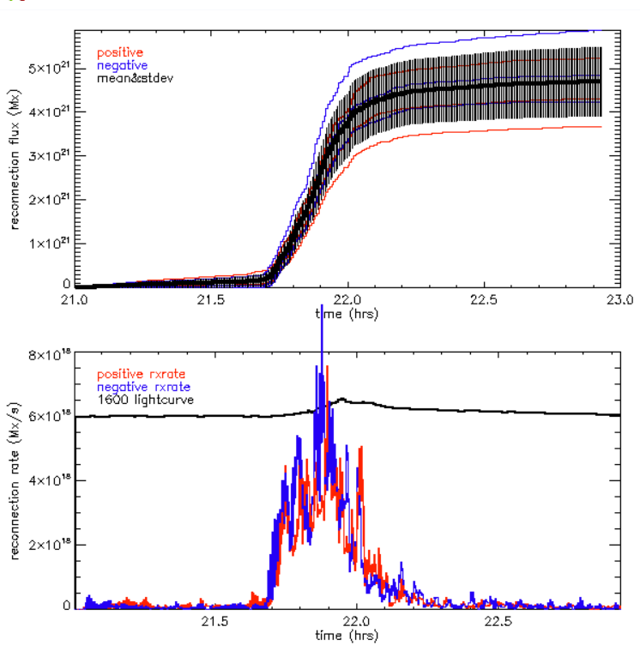

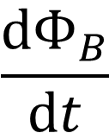
Reconnection Rate
$$Φ_{B}$$
$$\frac{ⅆΦ_{B}}{ⅆt}$$

Slide 7
Methodology of Measuring Reconnection Shear
Two dimensional projection of observed loops
Use of polarity inversion line instead of artificially drawn line to measure shear angle
Shear is the angle loops make against the polarity inversion line, the smaller the angle the greater the shear

Slide 8
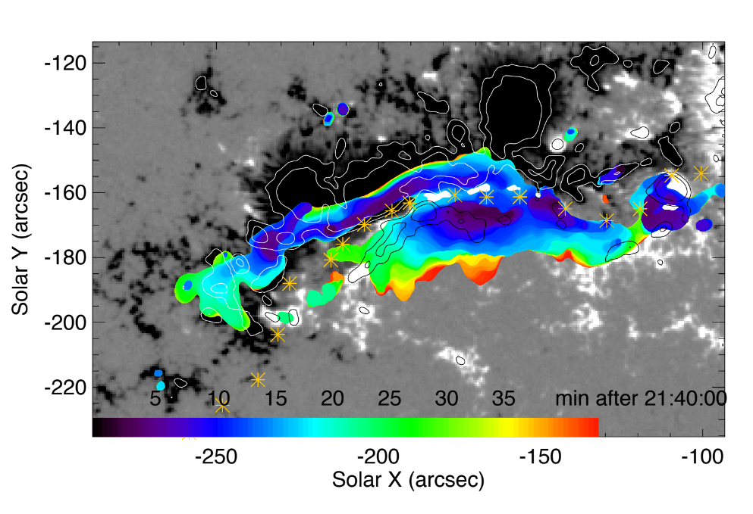
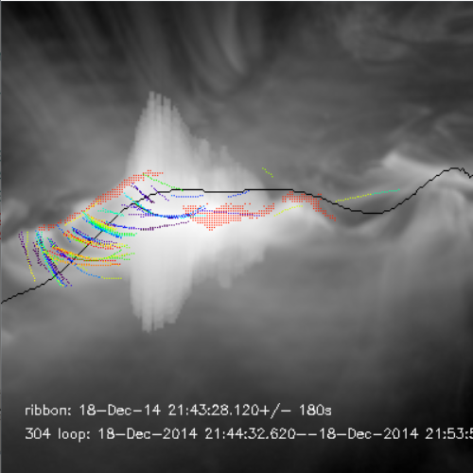
Map of magnetic flux with polarity inversion line plotted between flare ribbons

Slide 9
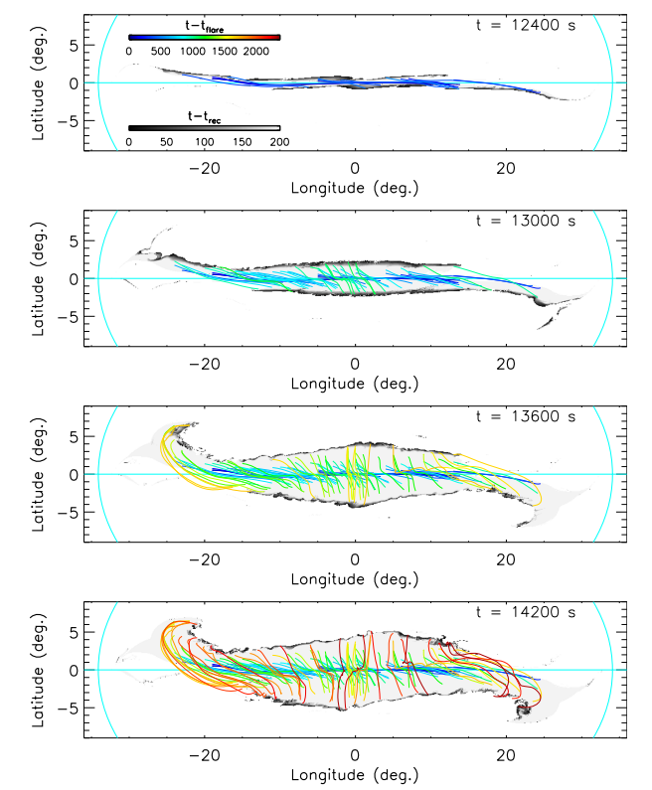
Numerical Simulation of Reconnection Shear
Dahlin et al
Notes:
Numerical simulation with symmetrical model

Slide 10
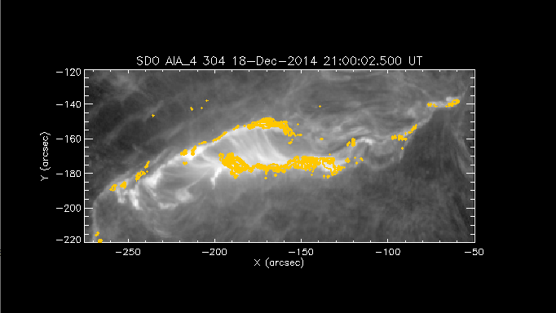
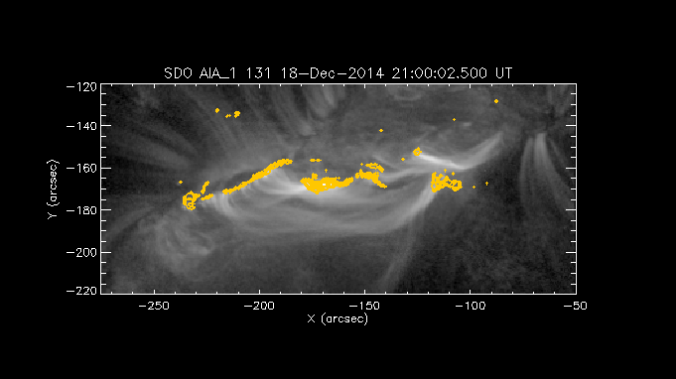
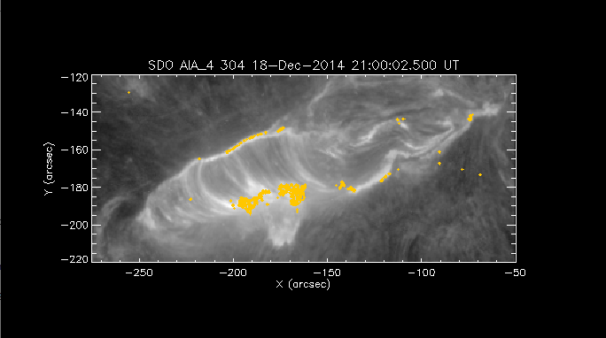
Preliminary Results
Three phases of Flare Evolution
High Shear
Rapid Expansion
Slow Expansion
Phase 2
Phase 1
Phase 3
Notes:
Need the polarity inversion line graphed onto the figures flare ribbons and loops no one has done this

Slide 11
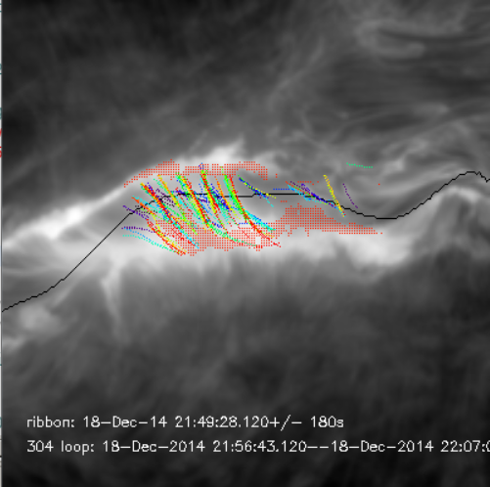
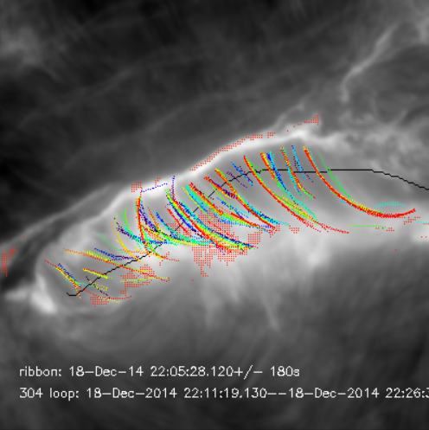
Traced Loops from Observations
Stage 1
Stage 2
Stage 3

Slide 12
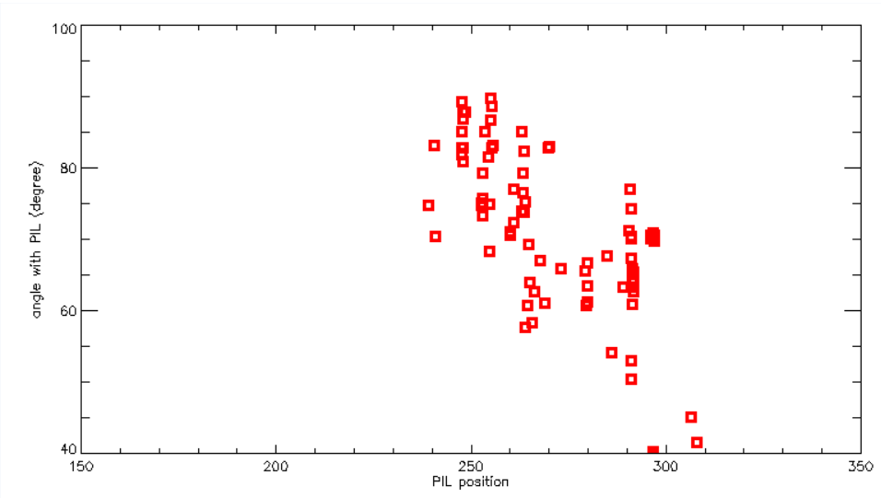
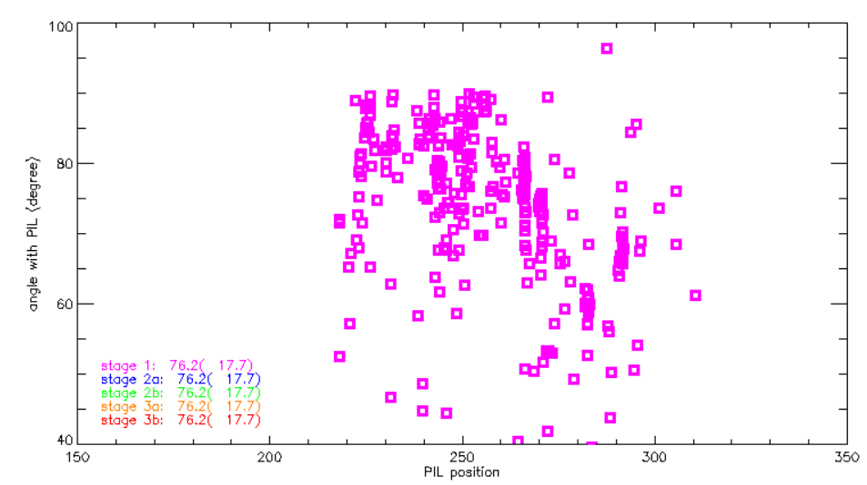
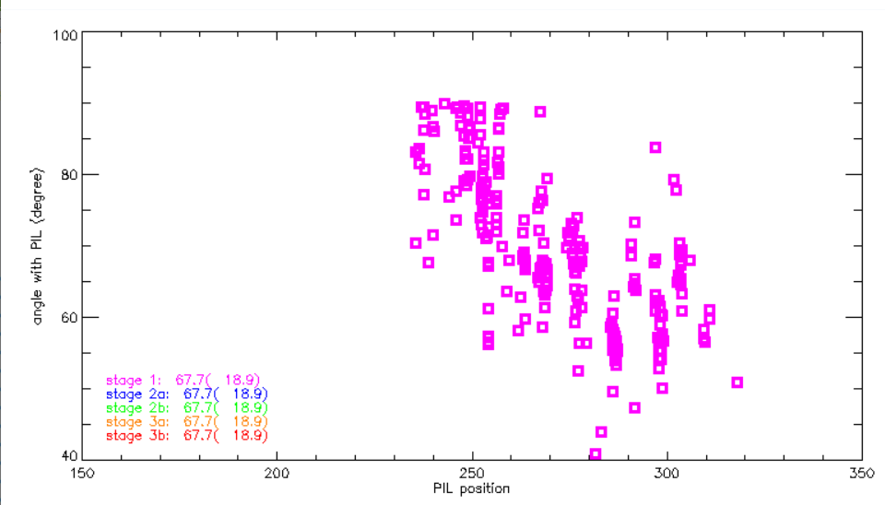
Results
Stage 3:
slow expansion
76°
Stage 1:
high shear
57°
Stage 2:
rapid expansion
68°

Slide 13
Conclusion
We have measured shear and reconnection rate with a new advanced analysis method
Quantify strong to weak shear evolution throughout different phases of flare
Our results can be used to constrain 3d magnetic field models, can derive the 3d shear

Slide 14
References
Joel T. Dahlin et al 2022 ApJ 932 94
Harry P. Warren et al 2018 ApJ 860 46

